Slide 1
Elliptic Curve Cryptography over GF(P) and GF(2^{m})
Lecture by :
Dr R Padmavathy
Dept of CSE,NIT warangal
rpadma@nitw.ac.in

Slide 2
Elliptic curves in Cryptography
Elliptic Curve (EC) systems as applied to cryptography were first proposed in 1985 independently by Neal Koblitz and Victor Miller.
The Discrete Logarithm Problem(DLP) on elliptic curve groups is believed to be more difficult than the corresponding problem in (the multiplicative group of nonzero elements of) the underlying finite field.

Slide 3
Definition of Elliptic curves
An elliptic curve over a field K is a nonsingular cubic curve in two variables, f(x,y) =0 with a rational point (which may be a point at infinity).
The field K is usually taken to be the complex numbers, reals, rationals, algebraic extensions of rationals, p-adic numbers, or a finite field.
Elliptic curves groups for cryptography are examined with the underlying fields of F_{p} (where p>3 is a prime) and F₂^{m} (a binary representation with 2^{m} elements).

Slide 4
Advantages of ECC
Same benefits of the other cryptosystems: confidentiality, integrity, authentication and non-repudiation but…
Shorter key lengths
Encryption, Decryption and Signature Verification speed up
Storage and bandwidth savings
Table 1:- key comparison in private and public key cryptography.
Security bits | RSA | ElGamal | Elliptic
80 | 1024 | 1024 | 160
112 | 2048 | 2048 | 224
128 | 3074 | 3072 | 256
192 | 7680 | 7680 | 384
256 | 15360 | 15360 | 512

Slide 5
Applications of ECC
Many devices are small and have limited storage and computational power
Where can we apply ECC?
Wireless communication devices
Smart cards
Web servers that need to handle many encryption sessions
Any application where security is needed but lacks the power, storage and computational power that is necessary for our current cryptosystems

Slide 6
Security of ECC?
Security of Public Key Cryptosystem: It relies on the evaluation of the computational difficulty of some families of mathematical problems and its complexity.
How do we analyze Cryptosystems?
How difficult is the underlying problem that it is based upon
RSA – Integer Factorization
DH – Discrete Logarithms
ECC - Elliptic Curve Discrete Logarithm problem
How do we measure difficulty?
We examine the algorithms used to solve these problems

Slide 7
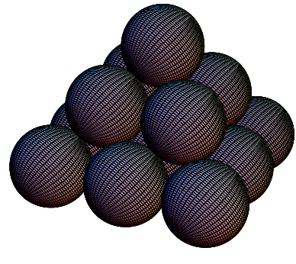
Introduction to Elliptic Curves Lets start with a small puzzle
What is the number of balls that may be piled as a square pyramid and also rearranged into a square array?
Soln: Let x be the height of the pyramid…
Thus,
We also want this to be a square:
Hence,

Slide 8
Graphical Representation
Y axis
X axis
Curves of this nature
are called ELLIPTIC
CURVES

Slide 9
Method of Diophantus
Uses a set of known points to produce new points
(0,0) and (1,1) are two trivial solutions
Equation of line through these points is y=x.
Intersecting with the curve and rearranging terms:
=>
We know that from quad. eq i.e. a+b+c=-co.iff(x²)
∴ 1 + 0 + x = 3/2 => x = ½ and y = ½
Using symmetry of the curve we also have (1/2,-1/2) as another solution.

Slide 10
Diophantus’ Method
Consider the line through (1/2,-1/2) and (1,1), i.e., y=m(x-x1)+y1=>y=3(x-1/2)-1/2=>y=3x-2
Intersecting with the curve we have:
Thus ½ + 1 + x = 51/2 or x = 24 and y=70
Thus if we have 4900 balls we may arrange them in either way. (means Pyramid or Square)

Slide 11
Introduction about Groups
A group is a non-empty set G equipped with a binary operation * that satisfies the following properties for all a, b, c in G:
1. Associativity: (a*b)*c = a*(b*c)
2. Identity: There exists an element e in G such that
a*e =e*a = a. We call e the identity element of G.
3. Inverse: For each a in G, there exists an element d in G
such that a*d = e = d*a. We call d is the inverse of a.
If a group G also satisfies the following property for all a, b in G:
4. Commutativity: a*b = b*a, we say G is an abelian group.
The order of a group G is denoted by |G| is the number of elements in G.

Slide 12
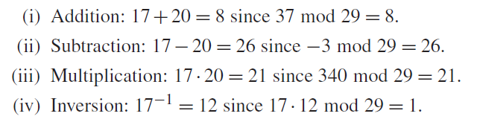
Galois Field GF(p)
It is a finite field and it consists of a set of integers {0,1,2,3….P-1} where p is a prime number. Additionally it satisfies the following arithmetic operations :

Slide 13
Galois Field GF(2^{m})
It is a finite field and is called binary finite field. It is a vector space of dimension m over GF(2) i.e. there exists a set of m elements {α_{m-1}, …,α₁, α₀} each α_{i} ∈{0,1} in GF(2^{m}) such that each a ∈ GF(2^{m})
a = α_{m-1}x^{m-1} + … + α₁x + α₀
Additionally it satisfies the following arithmetic operations :
For instance a = {a_{m-1},..a₁,a₀} and b = {b_{m-1},..b₁,b₀} ∈ GF(2^{m})
Addition : a + b = c = {c_{m-1},..c₁,c₀} where c_{i} = (a_{i} + b_{i}) mod 2 finally c ∈ GF(2^{m}) .
Multiplication : a . b = c = {c_{m-1},..c₁,c₀} where c is the remiander of the division of the polynomial a(x) . b(x) by an irreducible polynomial of degree m. c ∈ GF(2^{m})

Slide 14
Weierstrass Equation
Generalized Weierstrass Equation of elliptic curves:
Here, A, B, x and y all belong to a field of say rational
numbers, complex numbers, finite fields (F_{p}) or
Galois Fields (GF(2^{n})).

Slide 15
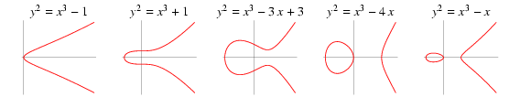
Types of Elliptic Curves
An elliptic curve is a plane curve char(k)≠2,3
Non-supersingular curves:
Koblitz curves:

Slide 16
Group laws of ECC where Char(p)>3
P and Q be two points on E_{(a,b)}(Fp) and O is the point at infinity.
1. Additive Identity : P+O = O+P = P
2. Negation : If P = (x₁, y₁) then (-P) = (x₁ ,-y₁) and P + (-P) = O.
3. Point addition : If P = (x1, y1) and Q = (x2, y2), and P and Q are not O. then P +Q = (x3 , y3) where
x₃ = λ² - x₁ - x₂
y₃ = λ(x₁ - x₃) - y₁
where λ = (y₂-y₁)/(x₂-x₁) if P ≠ Q
4. Point Doubling: P+P=2P,P not equal to –P.
x₃ = λ² - 2x₁ , y₃ = λ(x₁ - x₃) - y₁
Where λ = (3x₁²+a)/ 2y₁ if P = Q

Slide 17
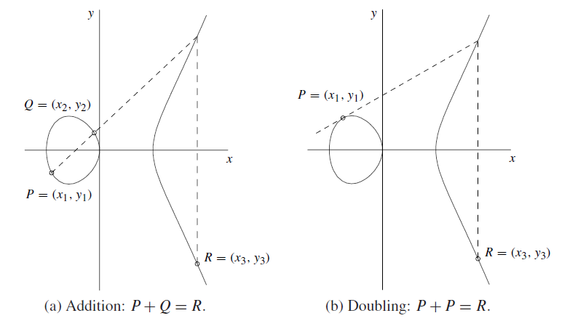
Point addition and Point doubling in graphical representation
P,Q,R are point on the curve.

Slide 18
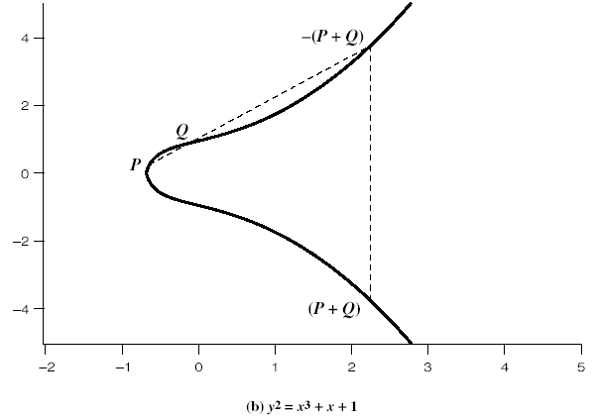
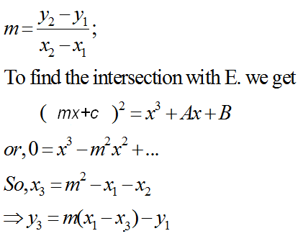
Addition in Affine Co-ordinates
y=mx+c
y
Let, P≠Q,
x
y²=x³+Ax+B

Slide 19
Doubling of a point
Let, P=Q, and take the derivative of Equation, derivation of y with respect to x.

Slide 20
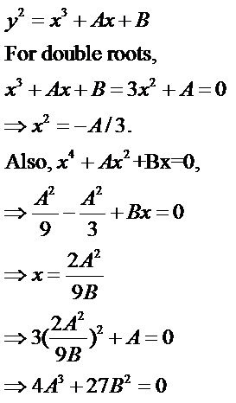
If Characteristics of field is not 2, 3:
Hence condition for no singularity is 4A³+27B²≠0
Generally, EC curves have no singularity

Slide 21
For Instance Point Addition and Doubling
Take an Elliptic Curve E_{(4,20)}:y²=x³+4x+20 ∈ F₂₉
Set of points generated using the curve E are
O, (2,6) (4,19) (8,10) (13,23) (16,2) (19,16) (27,2),(0,7) (2,23) (5,7) (8,19) (14,6) (16,27) (20,3) (27,27), (0,22) (3,1) (5,22) (10,4) (14,23) (17,10) (20,26), (1,5) (3,28) (6,12) (10,25) (15,2) (17,19) (24,7), (1,24) (4,10) (6,17) (13,6) (15,27) (19,13) (24,22)
Point addition :-where P=(5, 22), Q=(16, 27) , P+Q=(13,6)
λ = (y₂-y₁)/(x₂-x₁) mod (29) = ((27-22)/(16-5)) mod 29=(5/11)mod 29
=> (5*8) mod 29=11. (Because (11*8)=1mod 29)
x₃ = λ² - x₁ - x₂ (29)=> ((11*11)-5-16)mod (29)=> 100 mod 29=13
y₃ = λ(x₁ - x₃) - y₁ (29)=>(11(5-13)-22)mod 29 => -110 mod 29=6
Point Doubling :- where P=(5,22) 2P=P+P=(4,19)
λ = (3x₁²+a)/ 2y₁ (29) =>( (3(5*5)+4)/(2*22))mod 29=>13
x₃ = λ² - 2x₁ (29)=> (13*13)-2*5 (29)=> 14
y₃ = λ(x₁ - x₃) - y₁ (29)=>(13(5-14)-22 (29) => 6.

Slide 22
Points on the Elliptic Curve (EC)
Elliptic Curve over field L
It is useful to add the point at infinity
The point is sitting at the top of the y-axis and any line is said to pass through the point when it is vertical
It is both the top and at the bottom of the y-axis

Slide 23
The Points P,Q form Abelian Group
Given two points P,Q in E(Fp), there is a third point, denoted by P+Q on E(Fp), and the following relations hold for all P, Q, R in E(Fp)
P + Q = Q + P (commutativity)
(P + Q) + R = P + (Q + R) (associativity)
P + O = O + P = P (existence of an identity element)
there exists ( − P) such that − P + P = P + ( − P) = O (existence of inverses)

Slide 24
Elliptic Curve on a finite set of Integers Z/5Z
Consider y² = x³ + 2x + 3 (mod 5)
x = 0 ⇒ y² = 3 ⇒ no solution (mod 5)
x = 1 ⇒ y² = 6 = 1 ⇒ y = 1,4 (mod 5)
x = 2 ⇒ y² = 15 = 0 ⇒ y = 0 (mod 5)
x = 3 ⇒ y² = 36 = 1 ⇒ y = 1,4 (mod 5)
x = 4 ⇒ y² = 75 = 0 ⇒ y = 0 (mod 5)
Then points on the elliptic curve are
(1,1) (1,4) (2,0) (3,1) (3,4) (4,0) and the point at infinity: ∞
Using the finite fields we can form an Elliptic Curve Group
where we also have a DLP problem which is harder to solve…

Slide 25
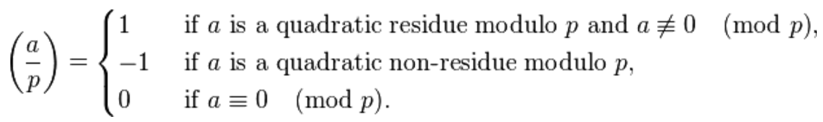
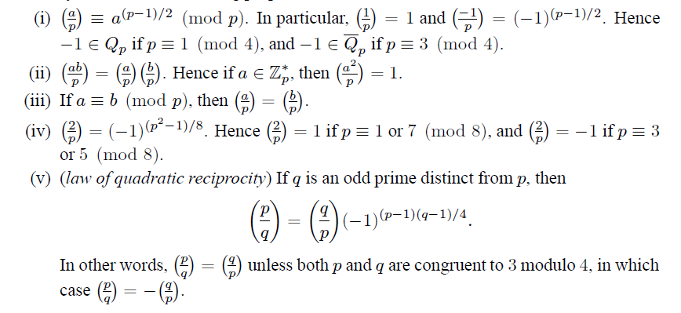
Continuation…
How do we say that y² = a(P) has solution with respect to F_{p} ?
Using Legendre and Jacobi symbol.

Slide 26
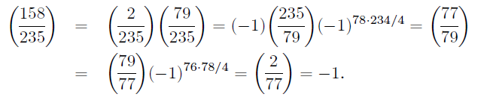
For Instance:
4th property 235=3(8) yield -1
5th property law of reciprocity
5th property law of reciprocity
4th property 77=5(8) yield -1

Slide 27
Implementation of scalar multiplication in ECC kP=P+P+……+P; k times k is scalar

Slide 28
ECC operations: Hierarchy
Level 0
Level 1
Level 2
Level 3

Slide 29
Scalar Multiplication: MSB first
Require k=(k_{m-1},k_{m-2},…,k₀)₂, k_{m}=1
Compute Q=kP
Q=P
For i=m-2 to 0
Q=2Q
If k_{i}=1 then
Q=Q+P
End if
End for
Return Q
Sequential Algorithm
Requires m point doublings and
(m-1)/2 point additions on the
average

Slide 30
Example
Compute 7P:
7=(111)₂
7P=2(2(P)+P)+P=> 2 iterations are required
Principle: First double and then add (accumulate)
Compute 6P:
6=(110)₂
6P=2(2(P)+P)

Slide 31
Scalar Multiplication: LSB first
Require k=(k_{m-1},k_{m-2},…,k₀)₂, k_{m-1}=1
Compute Q=kP
Q=0, R=P
For i=0 to m-1
If k_{i}=1 then
Q=Q+R
End if
R=2R
End for
Return Q
Can Parallelize…
What you are doubling and what
you are accumulating are
different…
On the average m/2 point
Additions and m/2 point
doublings

Slide 32
Example for scalar multiplication
Compute 7P, 7=(111)₂, Q=0, R=P
Q=Q+R=0+P=P, R=2R=2P
Q=P+2P=3P, R=4P
Q=7P, R=8P
Compute 6P, 6=(110)₂, Q=0, R=P
Q=0, R=2R=2P
Q=0+2P=2P, R=4P
Q=2P+4P=6P, R=8P

Slide 33
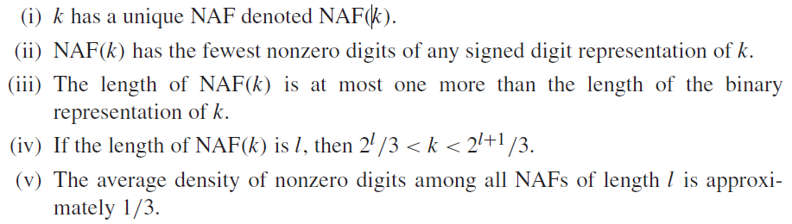
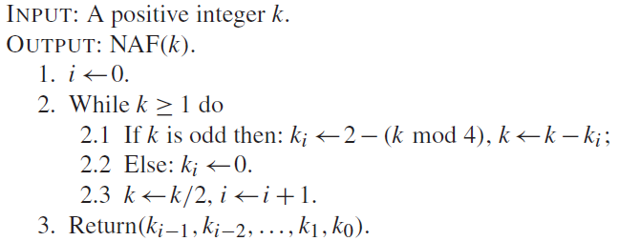
Scalar multiplication using NAF
In binary the remainders are {0,1}, but in NAF remainders are {0,1,-1},k is a scalar.

Slide 34
Continuation…
For instance k=31.
(Binary) = (NAF)
(11111) = (1 0 0 0 0 -1)
For instance k=61
(Binary) = (NAF)
(111101) = (1 0 0 0 -1 0 1)

Slide 35
Encode msg to Msg point on the curve
M to P_{M} point conversion.
1. X_{j}= 100 * M + j; where 0≤m<(P/100), 0≤j<100.
2. S_{j}=(X_{j})³+aX_{j}+b (mod P), (X₀,X₁,……..,X₉₉).
3. Legendre(S_{j,}P)=1.
Then P ≡ 3 mod 4. Y_{j}=(S_{j}) ^{(p+1)/4}(mod P)
else inc(j) , goto step 1.
output P_{M} =(X_{j},Y_{j}).
P_{M} to M convertion.
1. m=Floor(X_{j}/100).

Slide 36
Encryption & Decryption Process using Elliptic Curve Cryptosystems (ECC)

Slide 37
Key Generation:
Alice
Bob
A sending to B
Suppose Alice wants to send to Bob an encrypted message.
Both agree on a base point B. Alice and Bob create public/private keys.
Alice
Private Key a ={ 1,2,……..P-1}
Public Key = P_{A} = a * B
Bob
Private Key b = {1,2,………..,P-1}
Public Key = P_{B} = b * B
Alice takes plaintext message M, and encodes it onto a point, P_{M}, from the elliptic group.

Slide 38
Encryption and Decryption (Cont…)
Alice chooses another random integer, k=[1, p-1]
The ciphertext is a pair of points
P_{C} = [ C1=(kB), C2=(P_{M} + kP_{B}) ]
To decrypt P_{M} from C1,C2, Bob computes ,using private key, b
P_{M} =C2 - b * C1.
Bob then takes this product and subtracts it from the second point from P_{C}
(P_{M} + kP_{B}) – [b(kB)] = P_{M} + k(bB) – b(kB) = P_{M}
Bob then decodes P_{M} to get the message, M.

Slide 39
Summary of ECC
“Hard problem” analogous to discrete log
Q=kP, where Q,P belong to a prime curve
given k,P → “easy” to compute Q
given Q,P → “hard” to find k
known as the elliptic curve discrete logarithm problem
k must be large enough
ECC security relies on elliptic curve logarithm problem
compared to factoring, can use much smaller key sizes than with RSA etc
for similar security ECC offers significant
computational advantages

Slide 40
Topic wise Preferred Textbooks
Group laws and scalar multiplication
Guide to ECC p.no=80,96.
Mathematical formulas, Legendre and jacobi symbol
Hand book of applied cryptography p.no 73
Massage point representation,ElGamal Elliptic curve cryptography
Elliptic curve cryptography & number theory(pg no – 173,174,175)

Slide 41
Implementation of ECC over GF(2^{m})

Slide 42
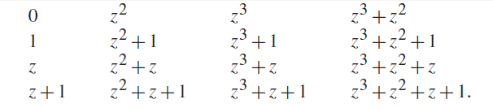
Binary Field GF(2^{m})
Binary Field
Field elements of Binary field F₂4

Slide 43
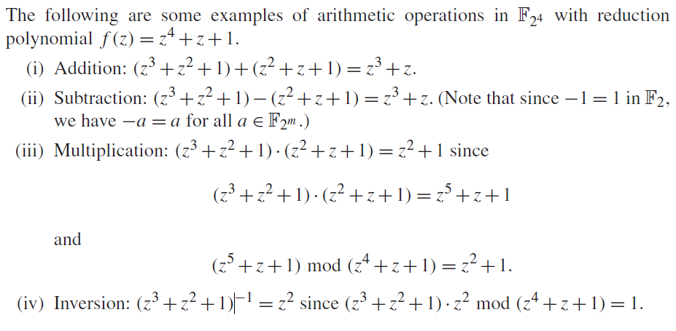
Conti…

Slide 44
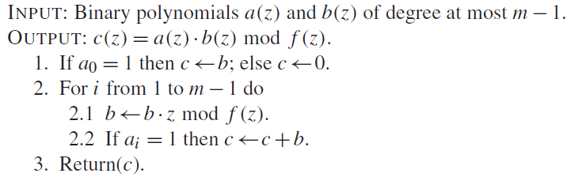

Conti…
Binary multiplication:
Binary squaring:

Slide 45
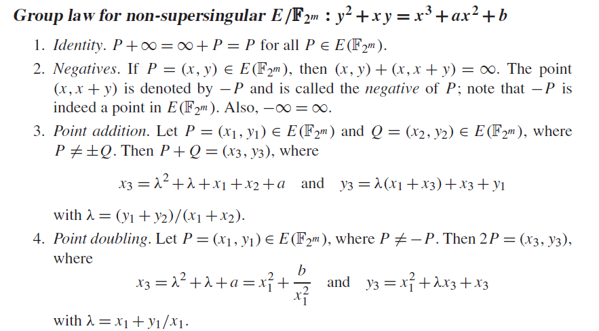
Group laws with respect to 2^{m}

Slide 46



Koblitz Curves
Koblitz curves are very efficient and it doesn’t require doubling.

Slide 47
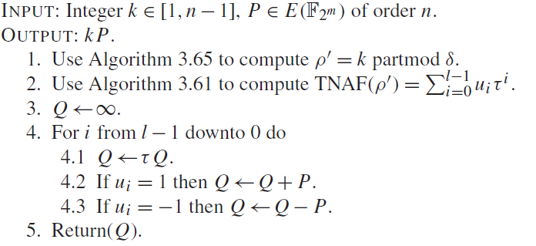
Scalar multiplication
Multiplying 7P using koblitz curves . Time complexity (m/3)A.

Slide 48
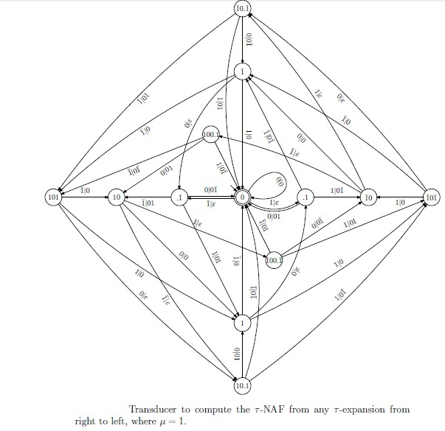
Applications of automaton in ECC

Slide 49
DST,DRDO Projects with ECC in NITW
The Project with title “Secure SMS using Koblitz curve based ECC on Android devices” funded by DST.
Another Project title “Solving Discrete Logarithm Problem over GF(2^{m})” funded by DRDO.
Upcoming technology may use VOIP efficiently for voice communication for that SIP is one of the major protocol used in it. Trying to embed ECC in SIP protocol to increase the efficiency with same level of security.

Slide 50
References
J. Lopez and R. Dahab, “Fast Multiplication on Elliptic Curves over GF(2^{m}) without pre-computation”, CHES 1999
K. Fong etal, “Field Inversion and Point Halving Revisited”, IEEE Trans on Comp, 2004
Koblitz.N., “Elliptic Curve Cryptosystems,” Math. Computation, vol. 48, pp. 203-209, Jan. 1987.
Solinas. J.A., “Efficient Arithmetic on Koblitz Curves,” Design, Codes and Cryptography, vol. 19, pp. 195-249, Mar. 2000.
Avanzi.R.M., Ciet. M., and Sica.F. Faster Scalar Multiplication on Koblitz Curves combining Point Halving with the Frobenius Endomorphism. Proceedings of PKC 2004, LNCS 2947, Springer 2004.
Knudsen. E.W., Elliptic Scalar Multiplication Using Point Halving. In: Proceedings of ASIACRYPT 1999, LNCS 1716, pp. 135-149. Springer, 1999.
Sujoy Sinha Roy, Chester Rebeiro, Debdeep Mukhopadhyay, Junko Takahashi and Toshinori Fukunaga, Scalar multiplication on Koblitz curves using τ2 – NAF, 2009.
Fong. K., Hankerson. D., Lopez. J., and Menezes. A,”Field inversion and point halving revisited”. IEEE Transactions on Computers 53(8):1047-1059, 2004.

Slide 51
Books:
Elliptic Curves: Number Theory and Cryptography, by Lawrence C. Washington
Hand book of applied cryptography, Alfred J. Menezes
Guide to Elliptic Curve Cryptography, Darrel R. Hankerson, A. Menezes and A. Vanstone
http://cr.yp.to/ecdh.html ( Daniel Bernstein)

Slide 52
Thank You
Doubts?

